Slide 1
Outstanding questions regarding air-sea interaction and near-surface processes?
How can satellites be used to find answers?

Slide 2
Outline:
Not this: “Here is what we know. Any questions?”
This: “Here are some interesting questions. Here’s what we don’t understand yet. This is important, yet still puzzling. This is what we could make progress on together.”
Elizabeth: 1-D perspective; regional and global problems
Mark: 2-D perspective with small scale variations
Notes:
I’m thinking of myself here as a moderator. Many of you in the audience know more about the upcoming missions and questions of interest. I’ve polled other colleagues from surface flux and air-sea interaction groups. Here is what they said and hoped that we could discuss.
We are trying to identify ways that we can direct our efforts now.

Slide 3
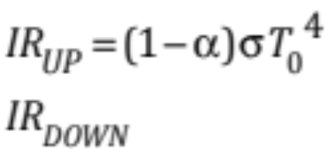
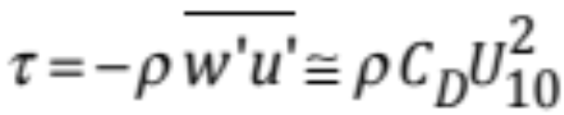
Fluxes across the air-sea interface
Latent heat flux
(turbulent moisture transport and surface evaporation)
q = specific humidity g of water vapor per kg of total air
Sensible heat flux
(turbulent heat transport and convection)
θ = potential temperature of dry air
Radiative heat flux
Momentum flux
~clouds~
Fairall et al. 1996, 2003, Edson et al. 2003

Slide 4
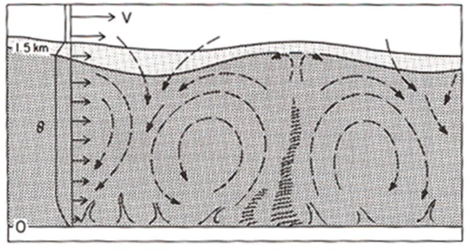
How do the sensible and latent heat fluxes impact clouds? c/o C. Kummerow, R. Johnson, D. Randall, A. Soloviev
wind
free atmosphere not in contact with surface
entrainment across stable inversion
convectively unstable atmospheric mixed layer:
rising thermals
due to TKE generation from buoyancy and shear
z
height
Surface
x or y
horizontal scale
Positive surface buoyancy flux: F
Wyngaard 1990

Slide 5
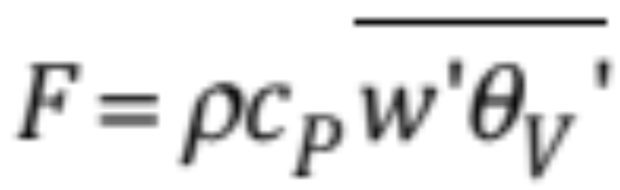

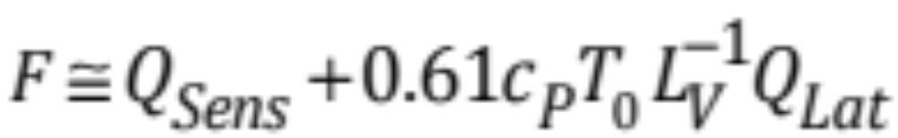
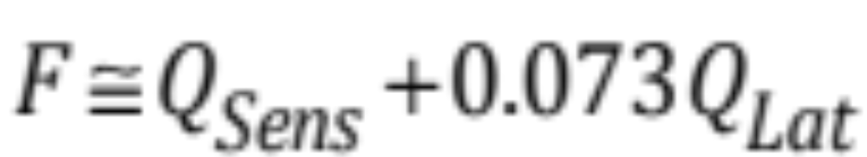
Atmospheric Buoyancy Flux, F
Johnson et al. 2001
Ruppert and Johnson 2015
Thompson et al. in prep
virtual potential temperature
~ buoyancy
moist air is lighter than dry air
specific humidity [g kg⁻¹]
Mass flux at top of atmospheric boundary layer is proportional to surface buoyancy flux (Lilly 1968)
Notes:
Only 7% of the magnitude of LHF is contributed to F, whereas 100% of the SHF is contributed to F.
LHF ~ 10-30 x SHF, but the fraction of F due to Qlat is still low compared to that of Qsens.
F is important because it help determines the flux at the top of the atmospheric boundary layer according to observations and has been implemented as a boundary layer scheme.

Slide 6
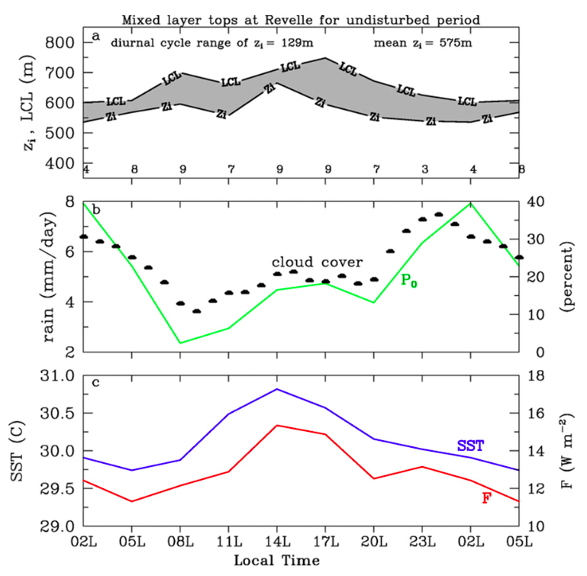
Diurnal warm layers cause large regions of relatively homogeneous, anomalously high, afternoon SST
… which increases the air-sea gradients of temp and moisture, ΔT and Δq, which enhances the sensible and latent heat flux despite low wind (< 7 m/s)
… which increases the atmospheric surface buoyancy flux, F
… which deepens the atmospheric mixed layer and shortens the distance that parcels need to travel to reach their condensation level (LCL)
… which explains the afternoon increase in clouds and rain
… heated rain layers are not well understood; observations from river outflows offer clues
Diurnal Cycle of Air-Sea Fluxes over Tropical Oceans
SST causes 2pm peaks
in ΔT and Δq
2 pm local
height
(meters)
Cloud condensation level
Mixed layer tops
Rain Rate
Kawai and Wada 2007, Johnson and Ciesielski 2017, Ruppert and Johnson 2015, 2016, Thompson et al. in prep
Notes:
It isn’t until the clouds have formed that the “latent” energy is realized. Before that, Qlat has a role in the buoyancy flux.
Boundary layer clouds are moving moisture, momentum, and heat from the sea surface into the FA.
The afternoon increase in rain and cloudiness, (the beginning, not the peak) coincides with the afternoon increase in F and SST
The LCL moves up a the same time as the mixed layer top, zi, but the distance between them is narrowed at 2 pm.
The LCL and zi both lower in height and become closer together between 11 pm – 2 am local, during which time precip and clouds also peak again.

Slide 7
How do waves influence air-sea fluxes? c/o J. Edson, C. Fairall, W. Asher, J. Thomson, M. Cronin
Questions:
(processes not linearly dependent on U₁₀)
How do wind-waves, swell, wave evolution, breaking waves impact:
  the drag coefficient?
  air-sea exchanges of heat, momentum, mass (H₂0, C0₂, DMS)?
How do wave-current interactions and currents impact air-sea exchanges?
… at low, moderate, and high wind speeds?
What are the air-sea fluxes in hurricanes?
What is the relative importance of evaporating sea spray, flow separation, and interface transformation at very high wind speeds?
Taylor and Yeland 2001, Oost et al, 2002, Thomson et al. 2013, Ardhuin et al. 2017, Donelan 2018
Notes:
The wave information has been baked into the calculation of the fluxes so far by virtue of the wave’s dependence on wind… but that hides the role of waves in the fluxes. There are several wave and current interactions that cannot be parameterized by the wind, which are necessarily missed by these formulations.
Swell has no relation to the local wind stress, and thus might have independent effects. Some possible parameterizations are included in the COARE routines as “jwave” options, based on wave age (Oost et al, 2002) or wave steepness (Taylor and Yeland, 2001), but we don’t really know if these work well.
Thomson: We know this happens in hurricanes, so the question is how much it matters in moderate conditions. The focus would be on swell, because we think the local wind sea is generally in equilibrium with the wind stress (e.g., Thomson et al, 2013). Swell has no relation to the local wind stress, and thus might have independent effects. Some possible parameterizations are included in the COARE routines as “jwave” options, based on wave age (Oost et al, 2002) or wave steepness (Taylor and Yeland, 2001), but we don’t really know if these work well.
Edson: How does the evolution of the wave field at extreme wind conditions impact the exchange of momentum at wind conditions above 20 m/s?
How does evaporating spray impact the exchange of heat and mass at high to extreme wind conditions?
What is the role of oceanic breaking waves on momentum, heat and mass (e.g., H2O, CO2 & DMS) at moderate to high winds.
How important is wind-swell interaction at low wind speeds?
Cronin: To get global fluxes, you need to have a good bulk algorithm and then you need to have accurate, highly resolved global estimates of the state variables. I believe the bulk algorithm could be improved by having better representation of the surface currents and roughness parameters in a wavy environment. I'm very excited about this new Doppler Scatterometer. I think that will definitely move the field forward.
What are the air-sea fluxes in hurricanes? What is the relative importance of evaporating sea spray, flow separation, and possible transformation in the nature of the 'interface' at very high wind speeds.

Slide 8
How do waves influence air-sea fluxes? c/o J. Edson, C. Fairall, W. Asher, J. Thomson, M. Cronin
Solutions
Questions:
(processes not linearly dependent on U₁₀)
Need: more direct flux observations in different regimes in order to train bulk algorithms
  high wind, high wave, low wind, stable/unstable dT/dz
  Waves and bulk fluxes operate on different time scales…
Need: accurate, highly-resolved, global estimates of the state variables used to compute bulk fluxes
Need: Improved, adaptable bulk algorithm for estimation of fluxes from observations and models
  Surface roughness depends on waves, rain, gustiness; stability impacts heat and momentum transfers
Need: satellite observations of critical wave properties
  Doppler scatterometer
Once we know how fluxes are related to remotely-sensed wave properties (breaking, whitecaps, bubbles, wave height, spectra) and trace gas transfer (CO2, dms, etc) satellites may offer observations of critical wave properties to allow better global flux estimates
How do wind-waves, swell, wave evolution, breaking waves impact:
  the drag coefficient?
  air-sea exchanges of heat, momentum, mass (H₂0, C0₂, DMS)?
How do wave-current interactions and currents impact air-sea exchanges?
… at low, moderate, and high wind speeds?
What are the air-sea fluxes in hurricanes?
What is the relative importance of evaporating sea spray, flow separation, and interface transformation at very high wind speeds?
Taylor and Yeland 2001, Oost et al, 2002, Thomson et al. 2013, Ardhuin et al. 2017, Donelan 2018
Notes:
The wave information has been baked into the calculation of the fluxes so far by virtue of the wave’s dependence on wind… but that hides the role of waves in the fluxes. There are several wave and current interactions that cannot be parameterized by the wind, which are necessarily missed by these formulations.
Thomson: We know this happens in hurricanes, so the question is how much it matters in moderate conditions. The focus would be on swell, because we think the local wind sea is generally in equilibrium with the wind stress (e.g., Thomson et al, 2013). Swell has no relation to the local wind stress, and thus might have independent effects. Some possible parameterizations are included in the COARE routines as “jwave” options, based on wave age (Oost et al, 2002) or wave steepness (Taylor and Yeland, 2001), but we don’t really know if these work well.
Edson: How does the evolution of the wave field at extreme wind conditions impact the exchange of momentum at wind conditions above 20 m/s?
How does evaporating spray impact the exchange of heat and mass at high to extreme wind conditions?
What is the role of oceanic breaking waves on momentum, heat and mass (e.g., H2O, CO2 & DMS) at moderate to high winds.
How important is wind-swell interaction at low wind speeds?
Cronin: To get global fluxes, you need to have a good bulk algorithm and then you need to have accurate, highly resolved global estimates of the state variables. I believe the bulk algorithm could be improved by having better representation of the surface currents and roughness parameters in a wavy environment. I'm very excited about this new Doppler Scatterometer. I think that will definitely move the field forward.
What are the air-sea fluxes in hurricanes? What is the relative importance of evaporating sea spray, flow separation, and possible transformation in the nature of the 'interface' at very high wind speeds.

Slide 9
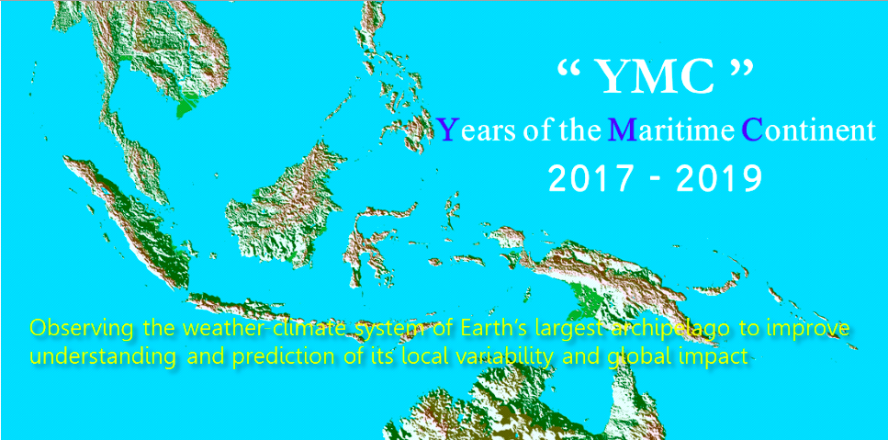
Diurnal-scale (extreme) air-sea interaction events c/o M. Cronin, E. Maloney, C. Zhang, P. Ciesielski
http://www.jamstec.go.jp/ymc
In many places and times, measurements with higher temporal and spatial resolution data are needed:
  Gustiness: vector average wind speed ≠ scalar average.
  In low-wind regions, SST has large diurnal cycle. Skin T ≠ bulk SST
  Fast-updating radiative flux products?
  Societally-relevant weather extremes operate on short time scales; coupled model experiments could be used for prediction.
  Even if measurements of state variables could reach sufficient temporal sampling, progress would also hinge on properly resolving geometry of mixed terrain: ice/sea, land/sea
    Coastal processes
    Maritime Continent and other island regions
    Marginal ice zones
Coordinating satellite constellation equator crossing could help resolve diurnal cycle (Tony Lee, Paul Chang)
High quality wind speed retrievals in rainy conditions are needed (Kilpatrick and Xie 2016)
Clayson and Bogdanoff 2013
Notes:
Relatively no measurements have been made in MC
Cronin: For satellites, I think there's hope for resolving the diurnal cycle by coordinating the constellation's equator crossings. See the figure based on one provided by Tony Lee, showing information compiled by Paul Chang.
Zhang:
If satellites could measure surface moisture and temperature well enough and fast enough, they’d also need to do so on small enough spatial scales to resolve marginal ice zone and land vs. sea contrast in the tropical MC

Slide 10
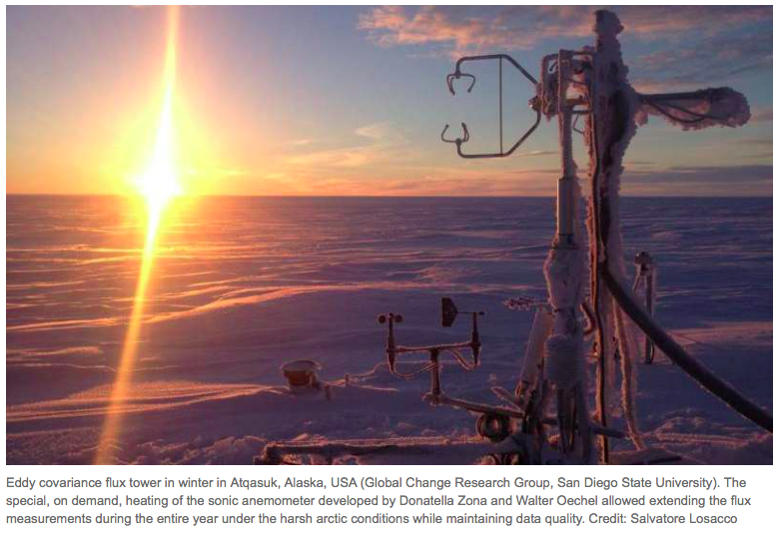
Long-term in-situ monitoring systems in mixed terrain: land-sea and ice-sea zones c/o A. Schweiger, C. Zhang, M. Cronin, Z. Liu, M. Moulton
Field experiments help, but extended records are needed to address societally-relevant sub-seasonal to seasonal questions
  Ex: arctic ice growth/retreat, equatorial warm pool climate modes
  Societally-relevant coastal processes may be of smaller scale or more quickly evolving than satellites can offer
  Arctic radiative flux challenges exist due to lidar attenuation, cloud blocking, difficulty in distinguishing low ice clouds from surface ice; instruments are aging and lack future surpport
A few in-situ flux monitoring stations could help validate existing flux products and satellite estimates
  Self-cleaning, self-powered, anti-vandalism
Heated sonic anemometer in the arctic (D. Zona, W. Oechel, S. Losacco)
Kay et al. 2013, Kato et al. 2011, Marchand et al. 2008, Mace et al. 2009, 2014, Liu et al. 2010, van de Poll et al. 2006
Notes:
Problems in these regions:
Persistent cloud cover blocking surface retrievals
Liquid water that attenuates signal
Rain that changes sea surface roughness
Low altitude ice clouds that cannot be distinguished from ice (emissivity problem in retrieval)
Emissivity of land vs. ocean near coasts; land/sea contrast is unresolvable subgrid scale noise; insufficient resolution of satellites to resolve key features relevant for coastal processes

Slide 11

Air-sea interaction over ocean eddies, sub-mesoscale features, and fronts: time-space conversion problems c/o L. Yu, M. Cronin, W. Asher, K. Drushka, J. Thomson
Science Questions
Remote Sensing Challenges
Along fronts, what are the relative roles of background SST, SST gradients, and SST-modified wind?
Along fronts, how do wave-current interactions (Ardhuin et al, 2017) and changes in relative wind forcing (Oerder et al, 2018) impact air sea exchange?
Ships can sample sub-grid scale variability, but not the entire grid and certainly not in the same time span as the satellite
Comprehensive sampling of sub-grid scale variability is likely intractable with ships or a single autonomous platform
  Autonomous fleets? Drifters? Gliders?
  case studies on air-sea coupling following eddy tracks; less composite patterns.
https://usclivar.org/meetings/
ocean-mesoscale-eddy-workshop
Renault et al. JPO 2016
Notes:
Cronin – largest fluxes are associated with (submesoscale) fronts.

Slide 12
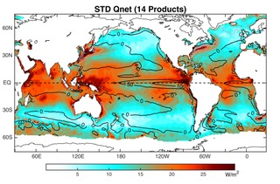
Uncertainties in flux measurements and products: averaging and errors c/o L. Yu, A. Schweiger, M. Cronin, S. de Szoeke
Std. Dev. Between 14 Q_{NET} products:
the bulk algorithm is highly non-linear; fluxes computed from averaged state variables is not equal to average of fluxes computed from highest resolution state variables
  S2S database is made up of daily-averaged quantities
fluxes need to be evaluated with highly-resolved state variables, or statistical distributions that are representative of extremes
measurement uncertainties in radiative fluxes are large
  Systematic biases also exist in radiative fluxes due to land/ice/sea cover errors and the presence of clouds/precip
Fluxes across frontal or convergence zones are often degraded, blocked, or their roughness is changed by precipitation and clouds
Direct flux measurements need to be made at particular heights in/out of the log-wind layer
25+ W m⁻²
1979-2014.
20-century reanalysis: 20CR, ERA20C,
1st generation reanalysis: NCEP1, NCEP2, ERA40,
recent reanalysis: CFSR, ERA-interim, JRA55, MERRA, MERRA2,
Ship product: NOCS2
Blended product: CORE2(included ISCCP radiation), OAFlux+ISCCP
Satellite product: OAFlux-HR + CERES EBAF v4
Yu et al. in prep
Clayson and Bogdanoff 2013 , Kato et al. J Climate 2013, Edson et al. 2013, L’Ecuyer et al. (2015); Rodell et al. (2015)
Notes:
What statistical distribution would be sufficient to recreate necessary goals/prediction/etc?
Yes, Edson asked a pointed question about the 3-axis sonic anemometer measurements we have been making on the wave glider. I think there are three big concerns with the measurement: 1) motion contamination, and 2) wave sheltering, and 3) turbulent scales near the boundary. I think we have satisfactory answers for 1 & 2, but perhaps not 3. Still, the results look pretty darn good…. see Figure 11 of attachment.
There is a big debate in the community about using COARE versus direct measurements. Some, including Edson, think it’s better to use COARE rather than to make direct measurements… unless you are one of the select few that can do it correctly.
SST and winds both have large variability at diurnal and subdiurnal time scales both under low-wind conditions (diurnal warming) and high-wind conditions (extreme events, e.g. typhoons). Consequently, to improve the global heat flux products, we must resolve diurnal cycle and frontal-scale variability. That's very challenging !
Systematic clouds (and rainfall) associated with fronts make remote sensing of frontal regions challenging

Slide 13
Using deep ocean, sea surface, and top of atmosphere fluxes to constrain earth’s surface flux energy imbalance c/o L. Yu, A. Donohoe, K. Trendberth
“The earth’s energy imbalance, between incoming SW and outgoing LW radiation from top of the atmosphere, is the most fundamental measure that the climate is changing.” – Kevin Trenberth
How to measure EEI?
  Measure it from space (after 2000), model it (with a good model, not with reanalysis), take inventory of all energy pathways (difficult), use observed fluxes (large systematic errors)
  Suggests measuring and tracking the tendency of ocean heat content: dOHC/dt, since OHC is where 90% of the EEI is stored… net surface heat fluxes can provide a sanity check for estimates: 0.5-1 W m⁻²
^{How do we do this regionally?}
Trendberth et al. 2014
Notes:
Radiative flux tendencies on the order of 1 W m-2 can explain 30 yr of sea ice loss in the arctic; our precision needs to be better than that. “Humbling”
Even if turbulent (sensible and latent) fluxes are constrained better, errors in radiative fluxes due to measurement error are still greater, not to mention their systematic biases due to clouds and variable land/ice/sea surface cover.

Slide 14

Societal relevance of coupled surface processes:
Sea level rise
Climate change
Coastal resilience/health
Pollution transport and dispersion
Waves and currents
Upwelling zones
Water cycle
Prediction
  seasonal to sub-seasonal: S2S
  extremes (droughts and floods)
  heat storage / ice retreat
Extreme events
  Monsoons
  Hurricanes
  Ice calving
Notes:
This is a hard time
We need to be able to sell physical oceanography to the US administration and/or forge international government partnerships.

Slide 15
Air-Sea Fluxes
- or –
Do we have to sweat the small stuff?
Mark A. Bourassa
COAPS & EOAS, Florida State University

Slide 16
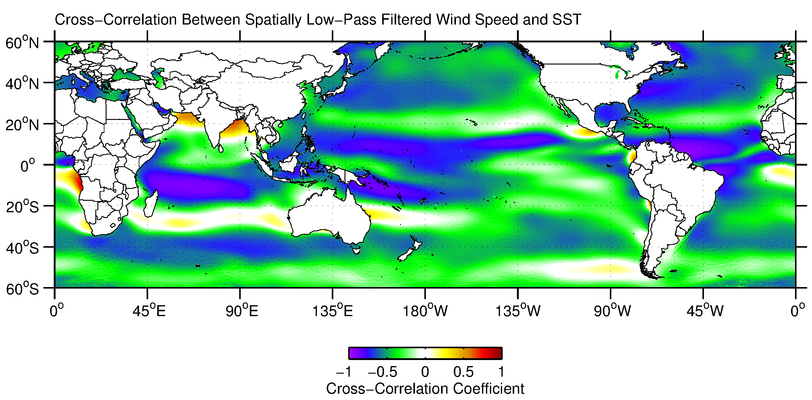
Two regimes for surface wind-SST coupling
On scales greater than 1500 km, the atmosphere drives the ocean predominantly through ocean mixed layer response to wind-modulated turbulent heat fluxes
QuikSCAT wind speed Reynolds OI v2 SST
11/1999-10/2009
Cayan (1992); Frankignoul et al (1986); Mantua et al (1997), among several others, have described this coupling in various forms

Slide 17
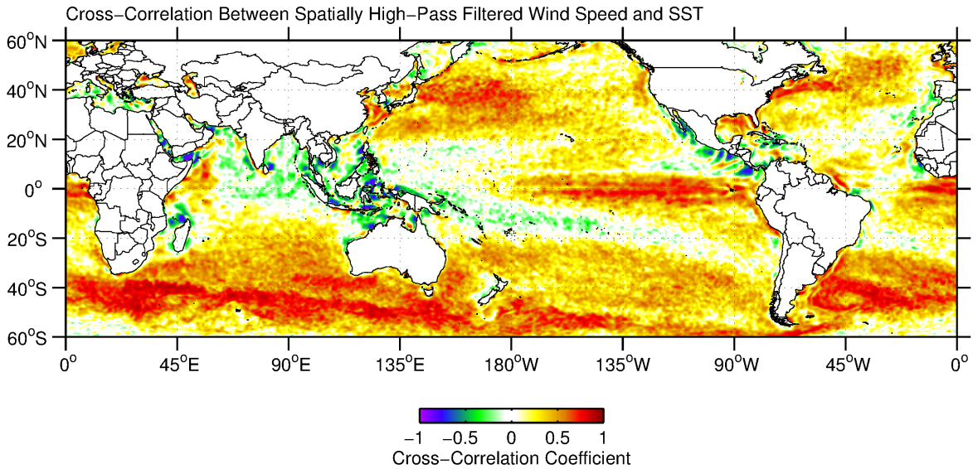
Two regimes for surface wind-SST coupling
On scales less than 1500 km, the ocean drives the atmosphere through atmospheric boundary layer response to SST-induced surface heating perturbations
QuikSCAT wind speed Reynolds OI v2 SST
11/1999-10/2009
Reviewed by Small et al (2008); see also Chelton et al (2004); Xie (2004)

Slide 18
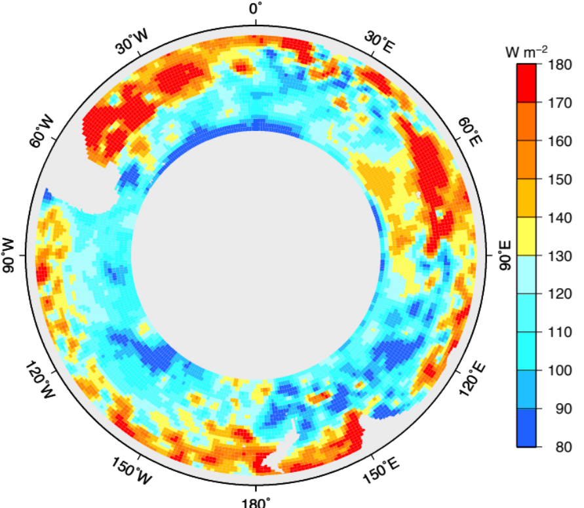

Regional Air-Sea Flux: Not so simple
Upper-ocean heat content rate of change
ECMWF
Locally heat fluxes do not explain rate of change of upper ocean heat content.
Possibilities:
Inadequate heat flux and/or upper ocean heat content data
Entrainment and advection matter
Gille
Notes:
A smattering of other Argo and air-sea heat flux-related results
6. Air-sea fluxes in the Southern Ocean explain the annual cycle in upper ocean heat content when you average over the entire Southern Ocean, but don't explain the local balances. Net temperature change of the Southern Ocean is consistent with about 0.6 W/m^2 input over the last 50 years; net freshening consistent with increased precipitation or ice melt.
Gille et al, in prep (Presentation at Ocean Sciences Meeting)

Slide 19
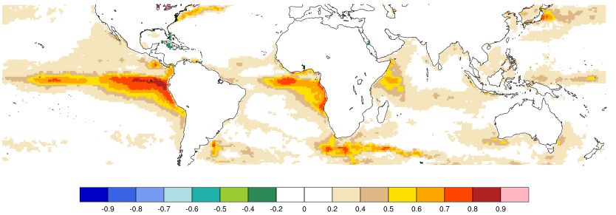
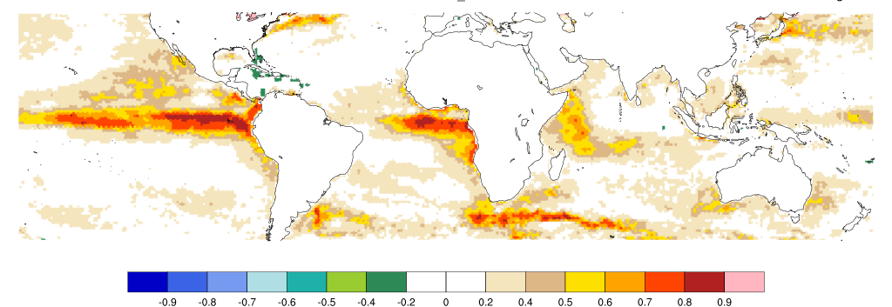
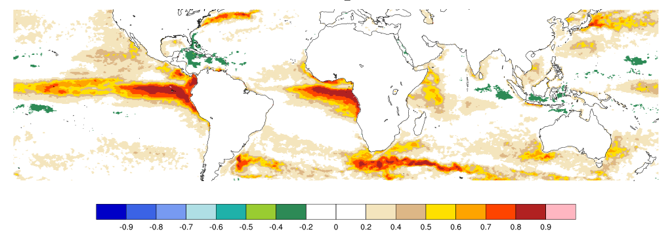
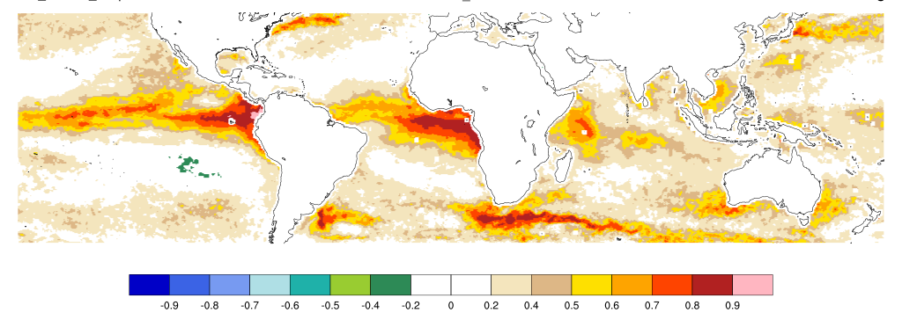
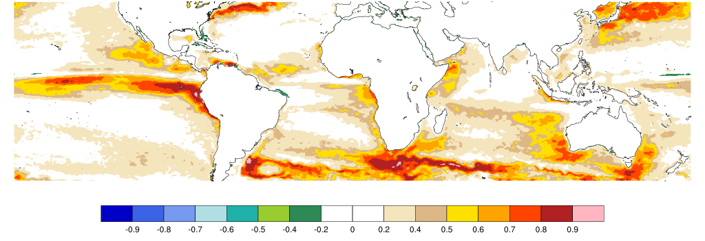
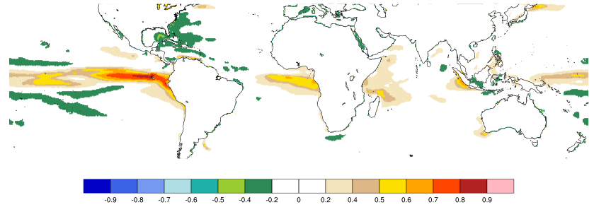
Correlation between monthly SST and latent heat flux
a) OAFLUX
b) OAFLUX 2002-2012
Observational and GCM data sets have loosely similar correlations.
The eddy resolving CESM model has similar results, but not the 1 degree model.
Strongly suggesting that ocean eddies, fronts and the like play important roles in the energy and water cycles.
c) J-OFURO-v3 2002-2012
d) SEAFLUX 2002-2012
e) HIGH RESOLUTION CESM
f) LOW RESOLUTION CESM
Stuart Bishop, J. Small, F. Bryan and R. Tomas (JCLIM, 2017)
https://journals.ametsoc.org/doi/abs/10.1175/JCLI-D-17-0159.1

Slide 20
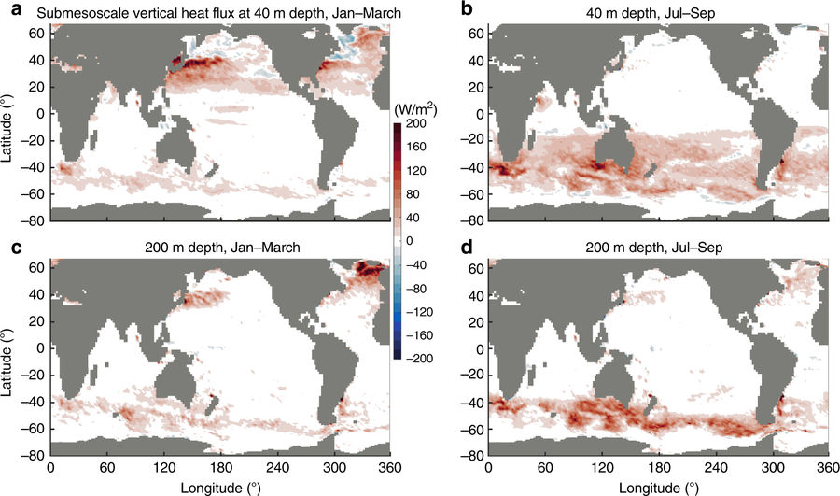
Heat Flux Due to Submesoscale Variability
Ocean submesoscales as a key component of the global heat budget by Zhan Su, Jinbo Wang, Patrice Klein, Andrew F. Thompson & Dimitris Menemenlis

Slide 21
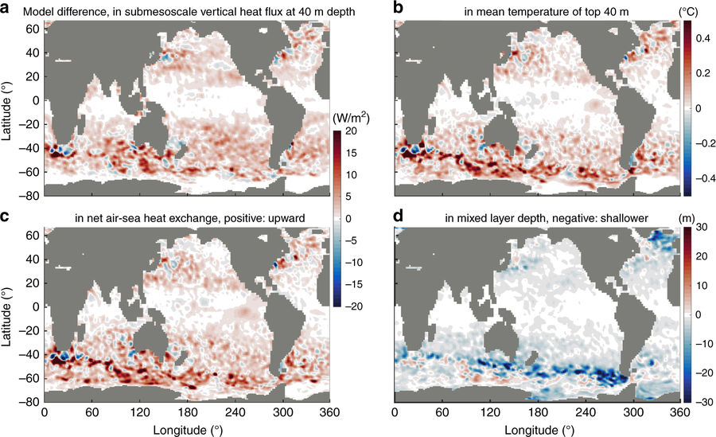
Submesoscale Changes Due to Model Resolution
(1/48° model minus 1/24° model)
https://www.nature.com/articles/s41467-018-02983-w/figures/3
Ocean submesoscales as a key component of the global heat budget

Slide 22
Questions
At mesoscale and finer scales, is the ocean forcing the atmosphere?
  This has been suggested, and shown statistically as mentioned on an earlier slide.
Are air-sea fluxes more complicated than we see in most models?
  If so, they can’t be much more complicated where smaller scale variability isn’t very substantial.
  But what about on small spatial scales?
  If so, so very small scales contribute to local biases?

Slide 23
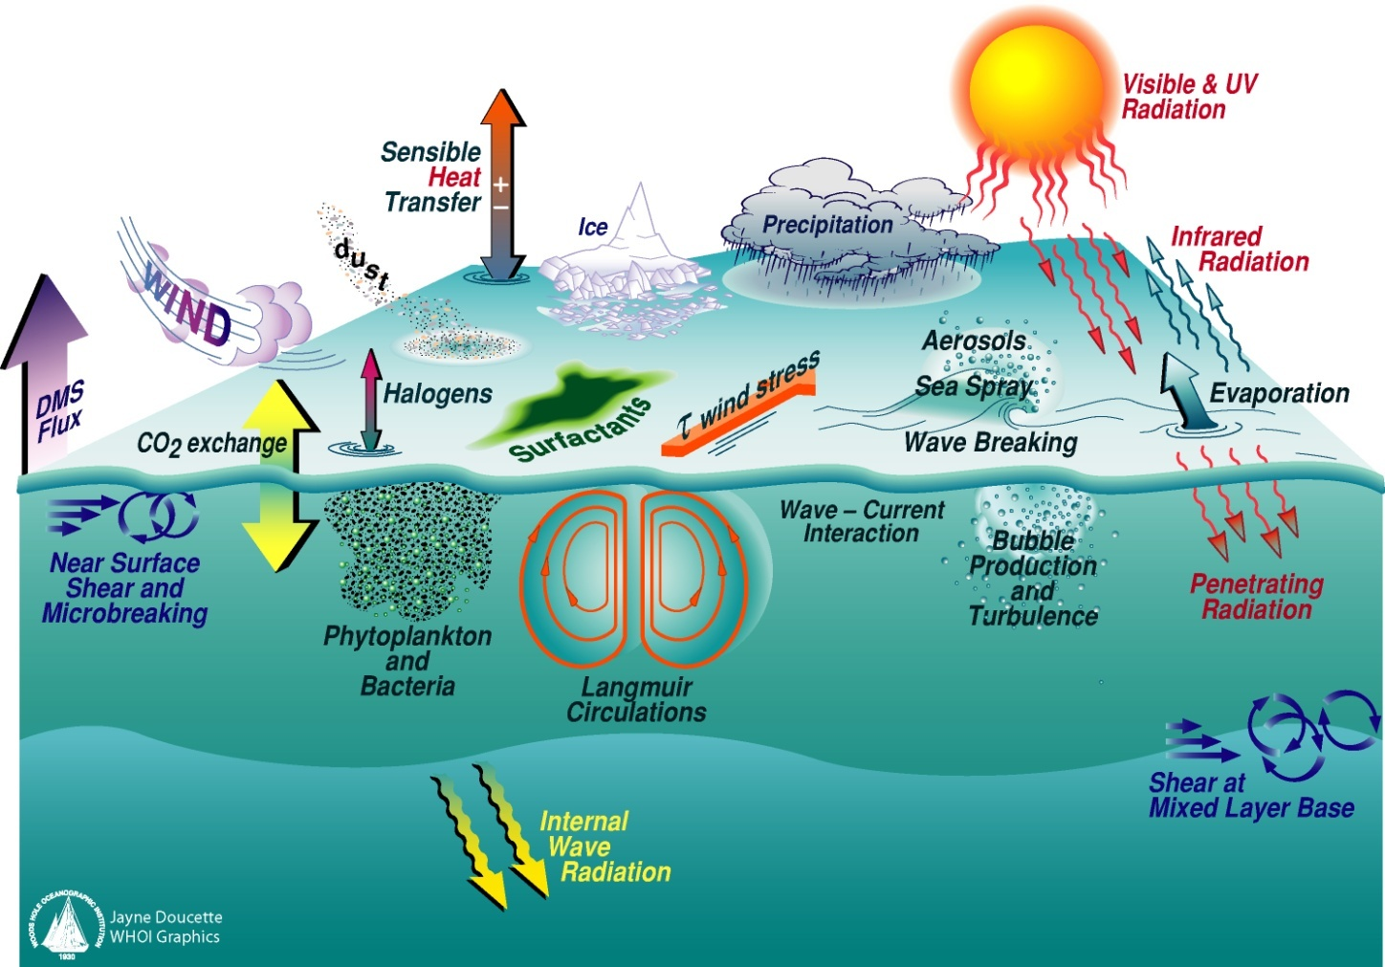
Processes Influencing Air/Sea Interaction
- Which are important?
Graphic created by WHOI

Slide 24
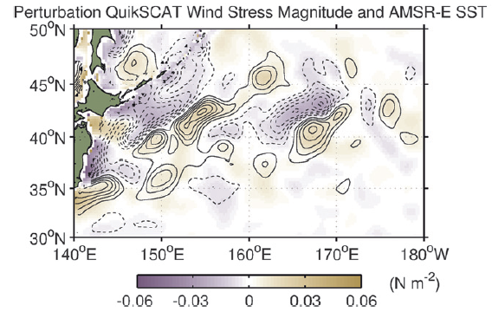
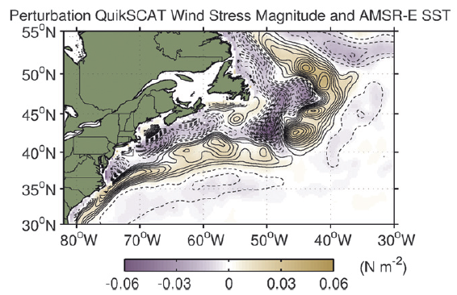
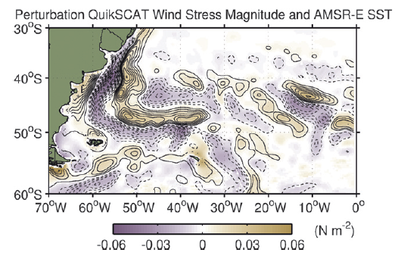
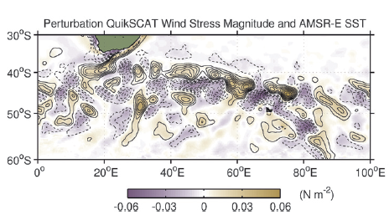
Small-scale response of surface wind to mesoscale SST perturbations

Slide 25
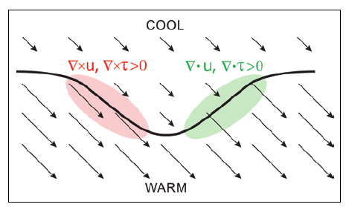
Mesoscale SST effects on curl and divergence
Wind speed response to SST leads to:
Divergence proportional to the downwind SST gradient
Curl proportional to the crosswind SST gradient
This conceptual model is first order – it does not consider that changes in the wind speed change the surface roughness and drag, which will also cause divergence and curl where the drag changes.
Chelton et al (2004)

Slide 26
Topic of Argument Since the 1980s
Larry O’Neill and Justin Small have wonderful one slide summary of the proposed physical mechanisms responsible for wind stress and SST coupling.
We will take these conceptual models to limiting cases:
  1) The atmospheric near surface temperatures does not respond to the boundary-layer Response driven by boundary-layer stability (air-sea temperature gradient)
  2) The atmospheric near surface temperature is slaved to the ocean, responding immediately to changes in SST, and the air temperatures change far enough up the atmospheric column to cause a gradient in surface pressure a change in the wind vector due to a new balance between the pressure gradient, the Coriolis force and friction.

Slide 27
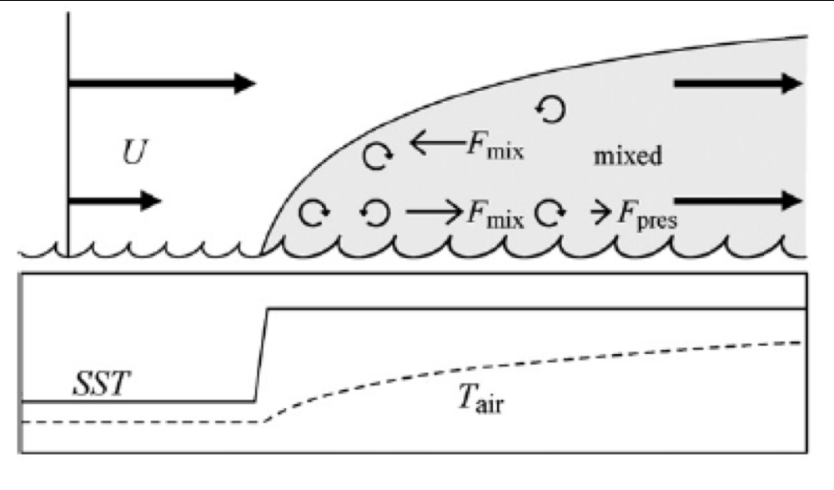
How Does the Atmosphere Respond To the Ocean?
Change in air = change in SST
Non-limiting case
Air does not respond
How can we determine which case applies?
Are their different conditions where each case would apply? If so, how do we identify them?
Small et al. (Dyn Atm Oc 2008)

Slide 28
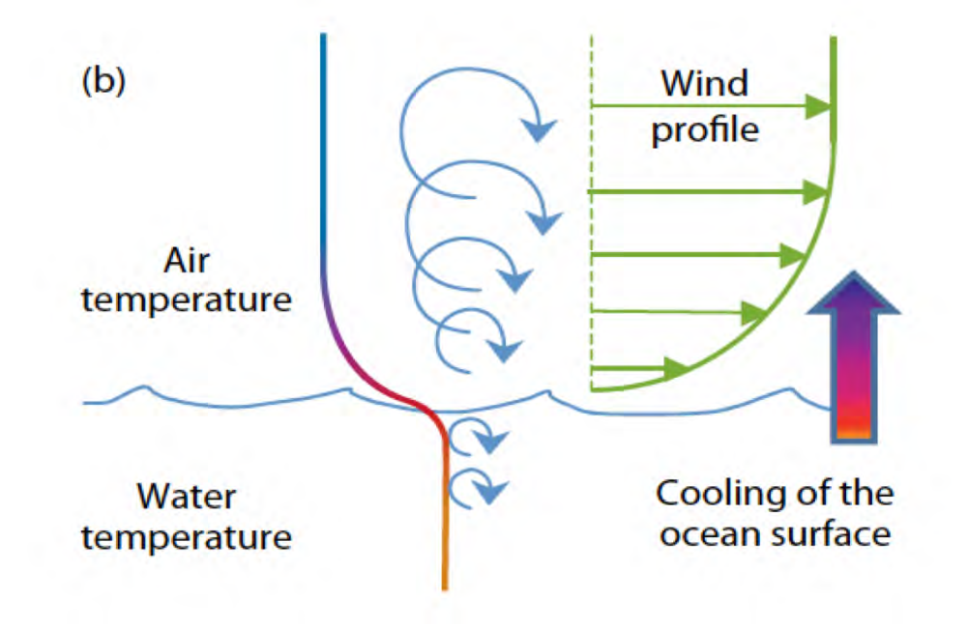
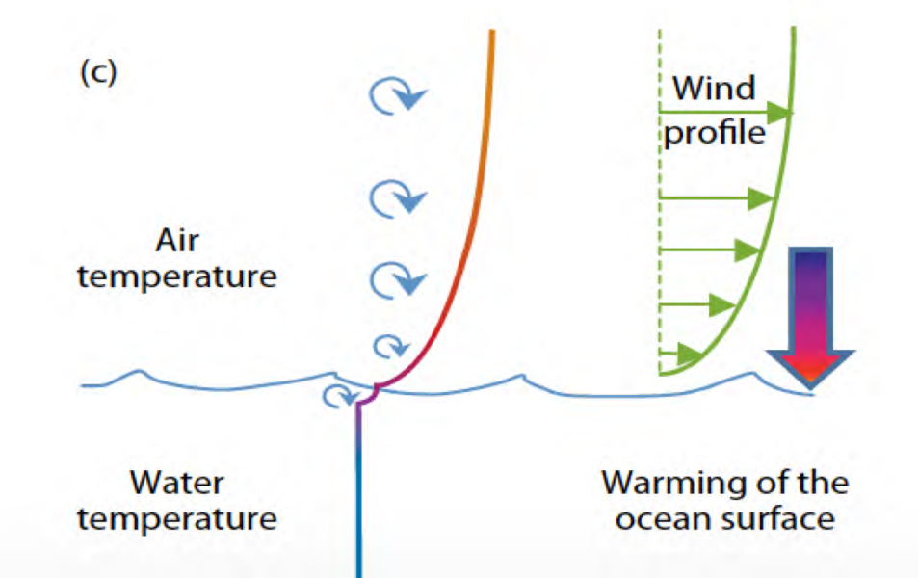
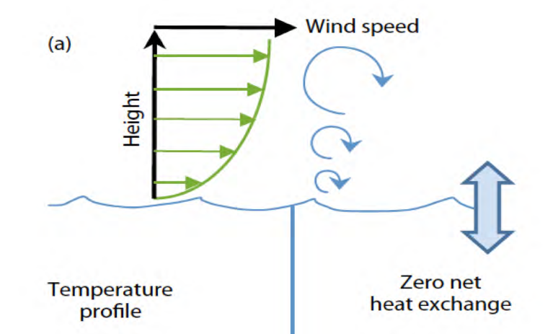
Fluxes & Air-Sea Temperature Difference
Neutral Stability: (a) The air density is constant with height
Unstable: (b) more dense over less dense. Ocean warms the air and the vertical flux of horizontal momentum (stress) is enhanced
Stable: (c) Qualitatively opposite of unstable
Bourassa et al. Oceanography (2010)

Slide 29
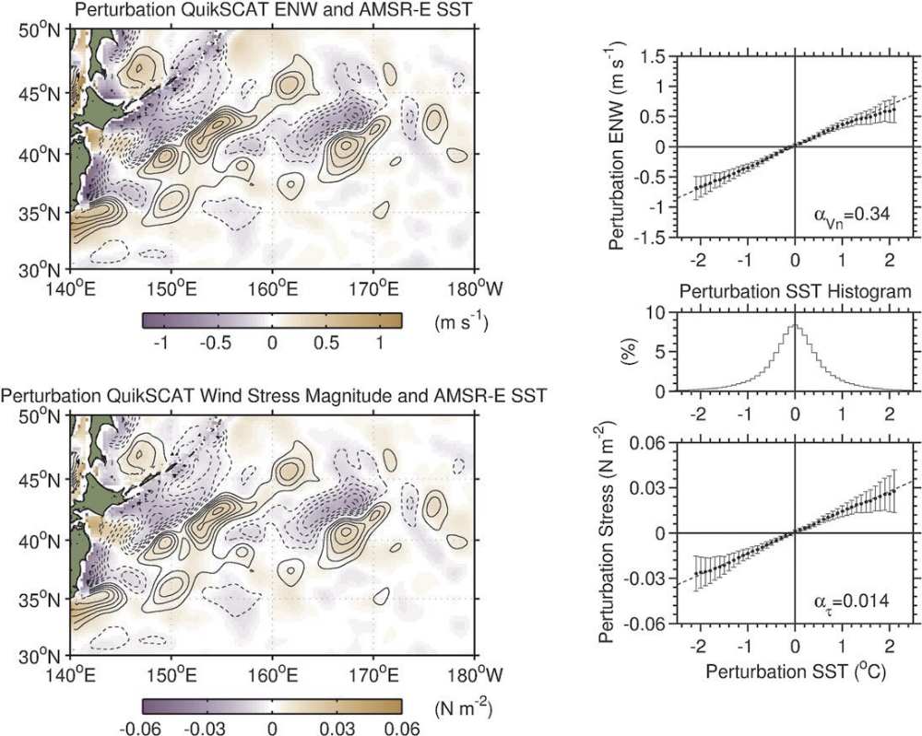
But…. What if air flows from warm to cold?
The pressure gradient model is equal and opposite in it’s response to positive and negative SST changes.
  Perturbation stress response should be equal and opposite for changes in SST.
Turbulent Fluxes (stress, sensible heat & latent heat) respond much more strongly to changes in stability when stably stratified.
  Perturbation stress response should not be equal and opposite for changes in SST.

Slide 30
Which is correct? The fight begins….
There is support for both mechanisms
  Arguments are most often based on pattern correlation
Rather than see what model is better I asked an undergrad to look at
air-sea temperature differences from research vessels crossing ocean fronts.
  Her initial results show both extreme cases and the middle case
  Different processes come into play!
The exciting questions become
  What conditions causes each case to happen?
  Are there feedbacks from the atmospheric response and any subsequent substantial ocean responses?
  Can we observe any of the above processes and feedbacks from satellite?

Slide 31
Near Surface Air Temperatures From Satellite
Multiple groups are producing 10m air temperatures (and humidity) derived from microwave radiances.
  Seaflux, WHOI, Carol Anne Clayson (seaflux.org)
  NOAA, Darren Jackson and Gary Wick (available through COAPS)
  NRL Stennis, probably soon to be available
A recent GODAE workshop revealed considerable interest in these products, prompting several producers to make the products available.
There are also regularly gridded products (some involving non-satellite data):
  Seaflux
  OAFLUX

Slide 32
Do Feedbacks Matter and on what scales?
On the large scales, it is clear that
  changing SST impacts the radiative heat budget, and hence the total heat budget
  Large scale wind patterns influence ocean circulation and oceanic energy transport, which contributes to smaller scale features
But what about smaller scales related to SST gradients, atmospheric fronts and surface currents?
  If mesoscale eddies are important to vertical energy fluxes, then small scale processes at the surface are also likely involved
  But are the feedbacks strong?

Slide 33
For What Processes Might We Expect Feedbacks?
Atmospheric convective processes
  Causes cooling at the ocean surface (e.g., Kilpatrick and Xie)
  Resulting in SST gradients, ocean mixing and a less unstable atmospheric boundary-layer
Ocean currents respond to stress and stress derivatives
  Stress is calculated as a vertical shear in wind and currents change the shear and hence the horizontal gradients in stress
  Ocean currents modify seastate, which modifies stress and stress derivatives (included in many wave models: SWAN, WW3, UMiami)
Seastate also changes with fetch (likely a big deal in extreme events) (e.g. Hwang, Holbach)
Curl of the stress is related to upwelling and downwelling
  Changing the ocean’s temperature profile and stability in both the atmospheric and oceanic boundary-layers, which changes stress
Frontogenesis is related to gradients of winds and SST
  Ocean upwelling and primary productivity (modifying radiative heating)
  All of which are important for air/sea coupling

Slide 34
Motivation for Interaction over Currents
Substantial bias and errors have been found in air-sea fluxes over western boundary currents (WBC) regions from numerical model products (Moore and Renfrew 2002; Roberts et al. 2012; Zhang et al. 2016).
Ocean modeling studies show that including currents reduces the Eddy Kinetic Energy production by about 25% (Renault et al., 2016a, 2016b)
  And the input was a little too low before considering currents
The impact of currents are seen in scatterometer wind stress (Plagge et al. )
If currents are important to surface forcing, then either
  there are additional factors than need to be considered in surface stress that are not already considered (e.g., seastate), or
  feedbacks that change other things, making currents more important through indirect processes
The near surface profile is dependent on stress, stratification and wave breaking; but dependencies are far from clear.

Slide 35
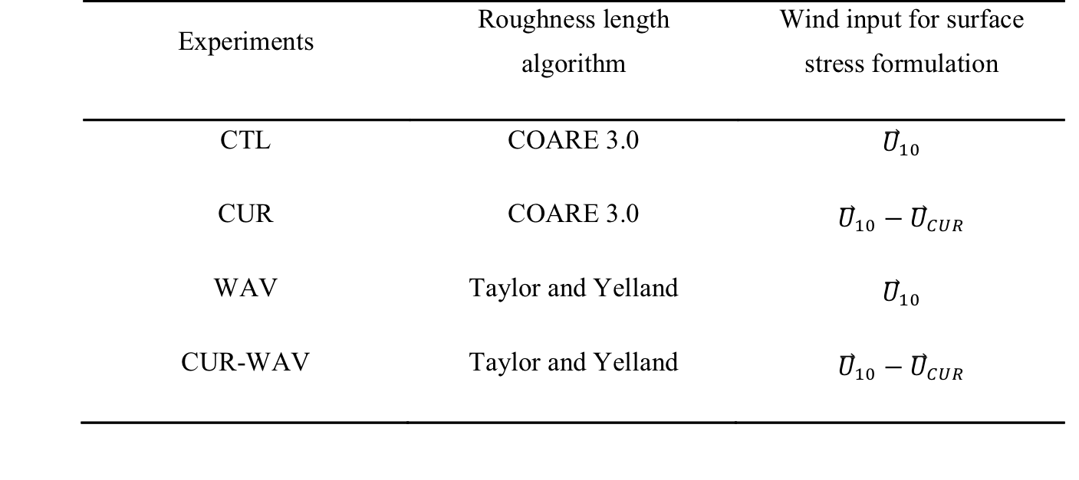
Experimental design for a two-way coupled model
These experiments were designed to separate the ocean currents’ effect on the wind stress from the wave effect. The four experiments differ only in how wind stress is calculated in the bulk parameterization equation.
Currents
Seastate
Currents & Seastate

Slide 36
Coupling among three modeling components
Wind stress, Surface heat fluxes
Radiation, Precipitation,
Sea level pressure
Ocean
(ROMS)
Atmosphere
(WRF)
Sea surface temperature
Surface currents
Surface currents
Wave length, height, period and direction
+
Modified MYNN
Wave
(SWAN)
10-meter wind
Wave height and wave length
Atmospheric, ocean and wave models are synchronized every 10 minutes to exchange data fields through the Model Coupling Toolkit (MCT).
Qi Shi and Mark Bourassa, Remote Sensing, in review

Slide 37
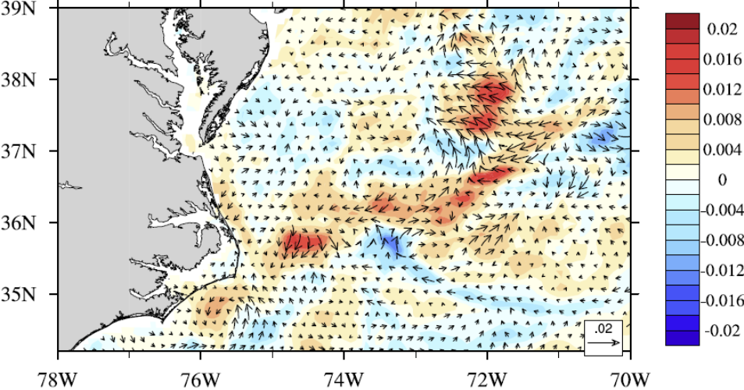
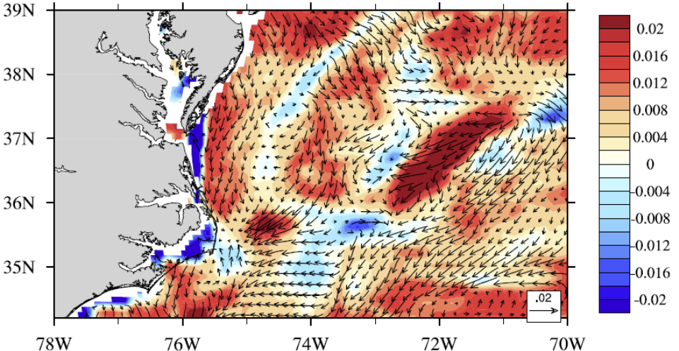
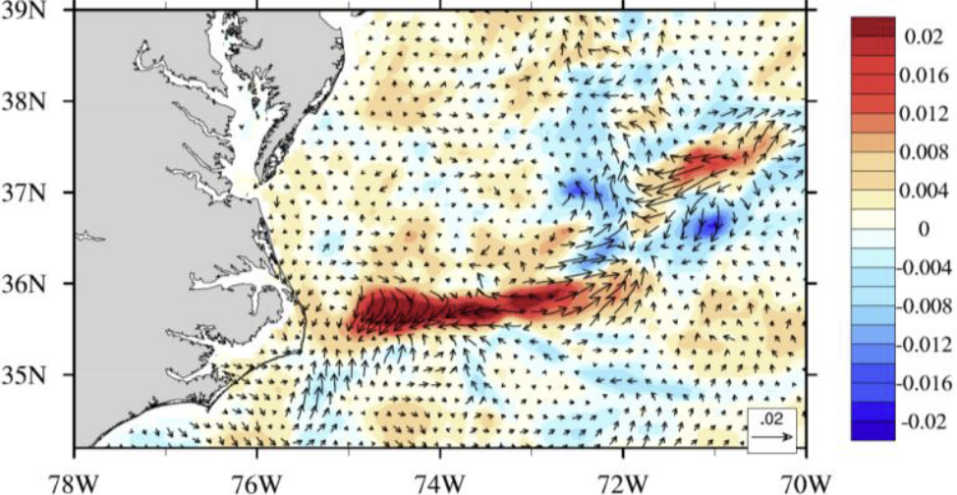
Changes in October Wind Stress Magnitude
Relative to model with stress independent of waves and currents
CUR-CTL
Not Reasonable
WAV-CTL
Not Reasonable
CUR&WAV-CTL
Seemingly Reasonable
Currents alone tend to reduce EKE production beyond reasonable values
Waves alone tend to increase stress
  But not as needed
Waves together with currents are not a linear sum of the two
  Good for ocean EKE
  Surface currents are critically important

Slide 38
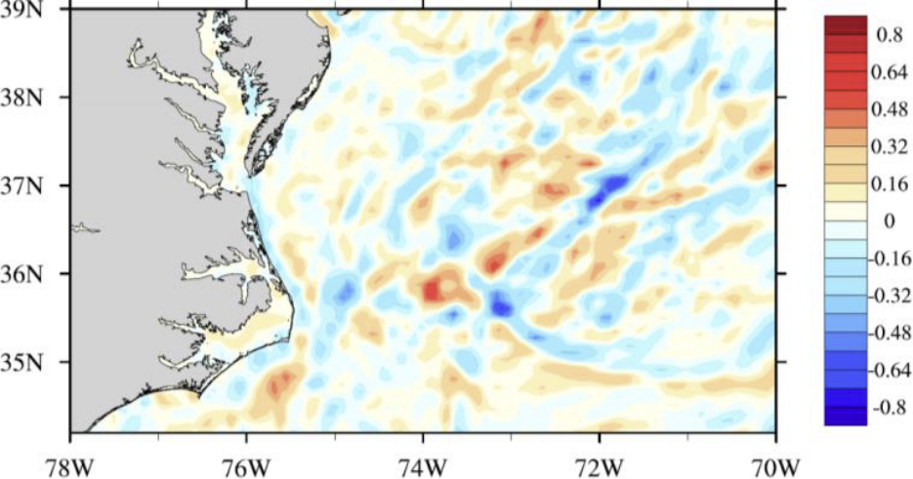
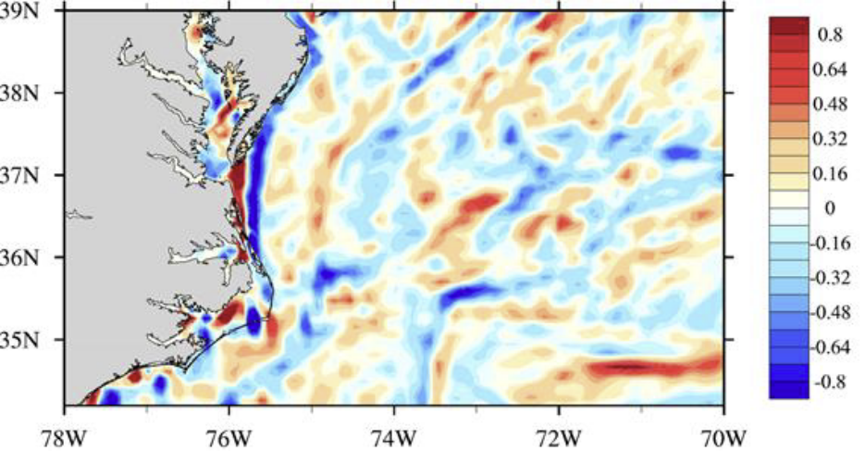
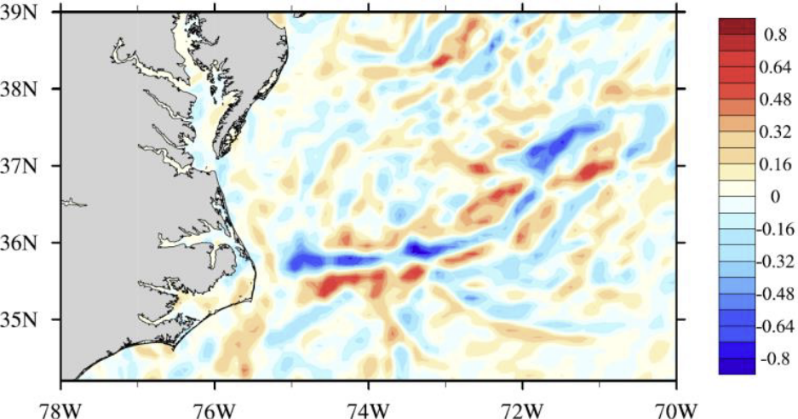
Changes in October Ocean Ekman Pumping
CUR-CTL
WAV-CTL
CUR&WAV-CTL
More like Observations
In the upper two images the mixed layer heat budget is dominated by horizontal transport processes.
In the bottom case, the heat budget is dominated by vertical motion
  Curl of stress is greater over SST gradients (more like observations)

Slide 39
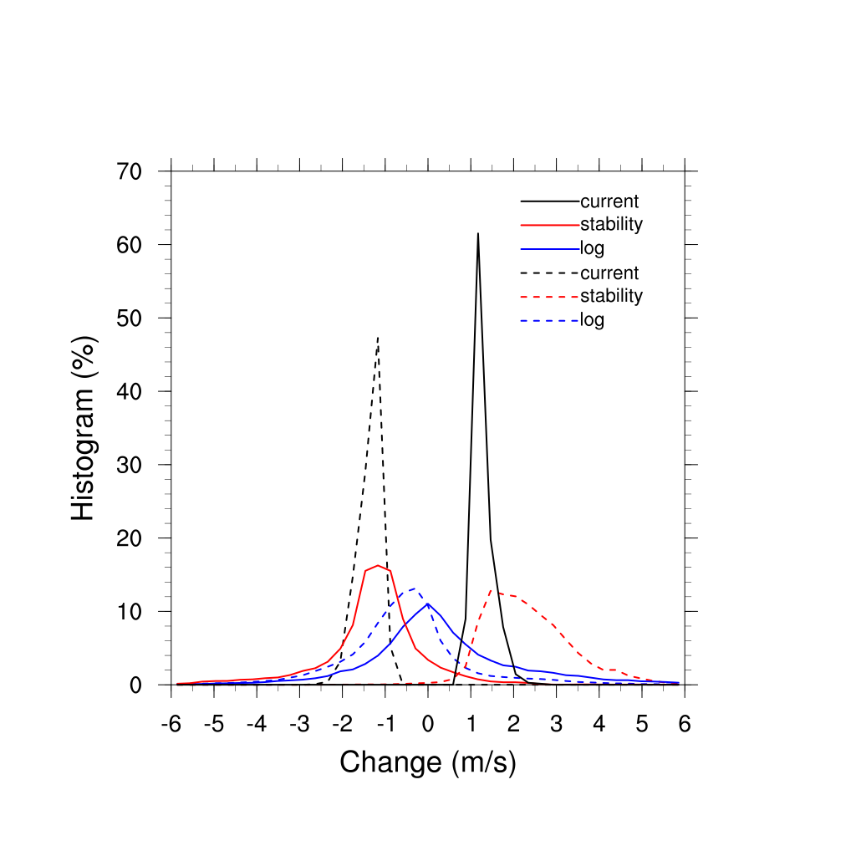
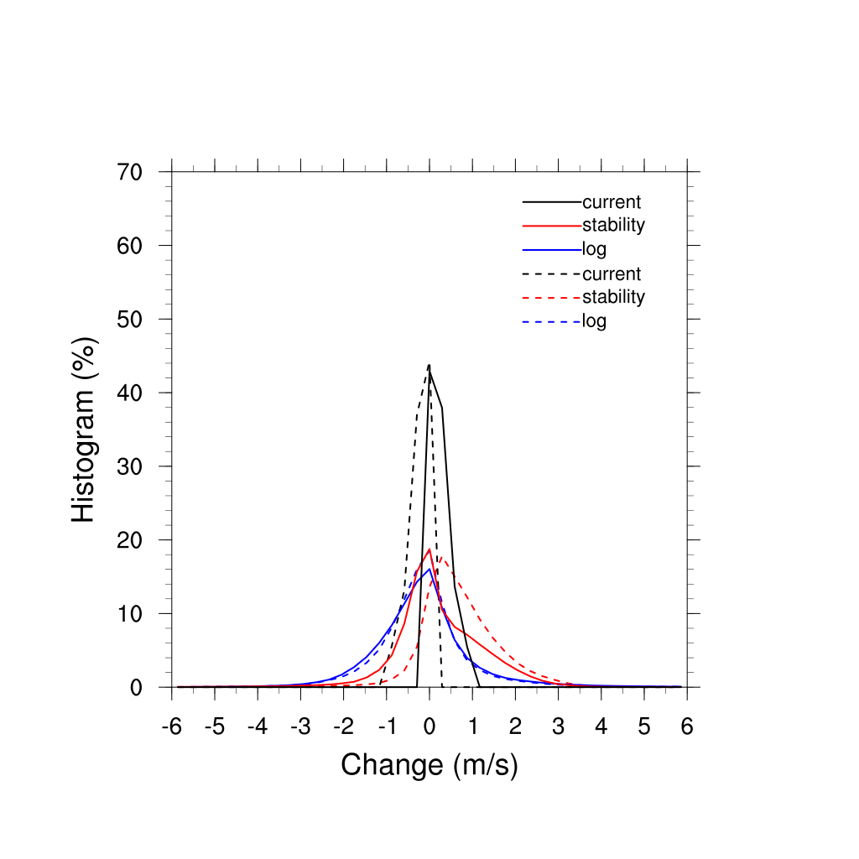
Surface Wind Response
Histograms of the difference of current, stability and log profile terms in the log-wind equation between CUR_WAV and WAVE experiments. The statistics are computed over strong-current (U_{s}>1m/s; left) and weak-current (U_{s}<1 m/s; right) regions. Dashed lines are associated with negative changes in currents.

Slide 40
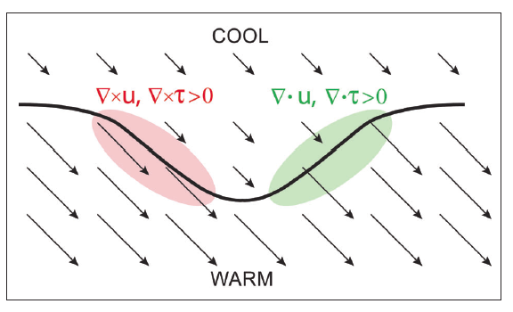
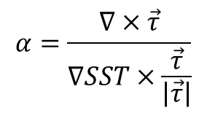
Sensitivity of the wind stress curl to the crosswind SST gradient
Currents have already been shown to have a large impact on the pattern of stresses
They also influence the pattern of SSTs (not shown in this version of the presentation)
The coupling coefficient will be shown to be highly dependent on the physics considered in the parameterization of stress.
Curl
Divergence
(Chelton et al., 2007)
Coupling coefficient
Notes:
Figure 2. Schematic illustration of the divergence and curl of the wind and wind stress fields that result
from spatial variations of the SST field. Near a meandering SST front (the heavy black line), surface winds
are lower over cool water and higher over warm water, shown qualitatively by the lengths of the vectors.
Acceleration where winds blow across the SST front generates divergence (green area). Lateral variations
where winds blow parallel to the SST front generate curl (red area). The divergence and curl perturbations
are proportional to the downwind and crosswind components of the SST gradient, respectively
(see Figure 3).

Slide 41

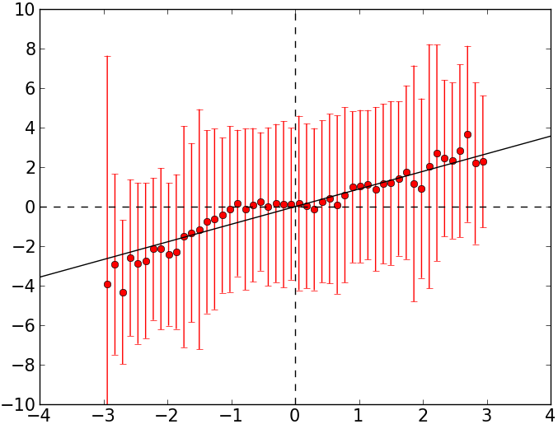
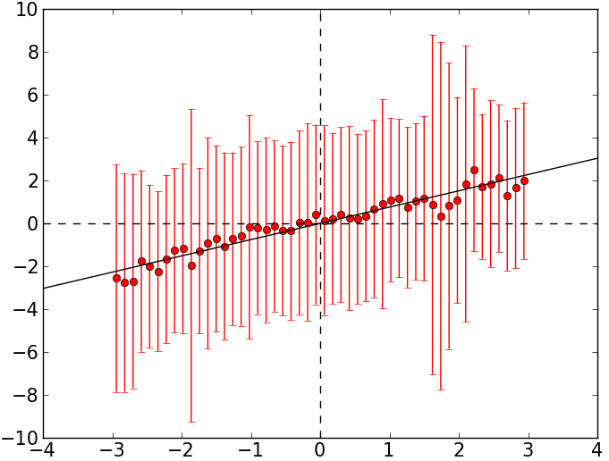

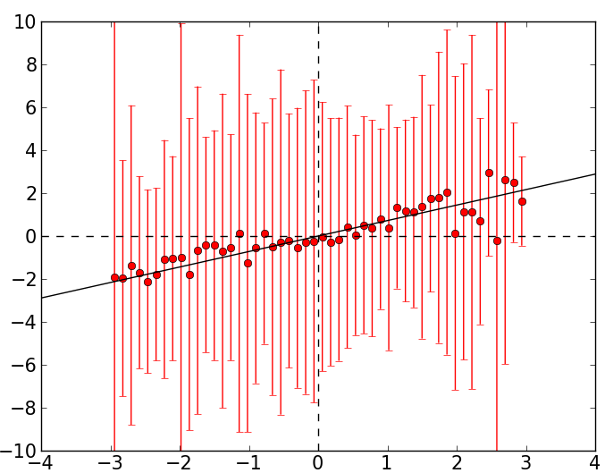
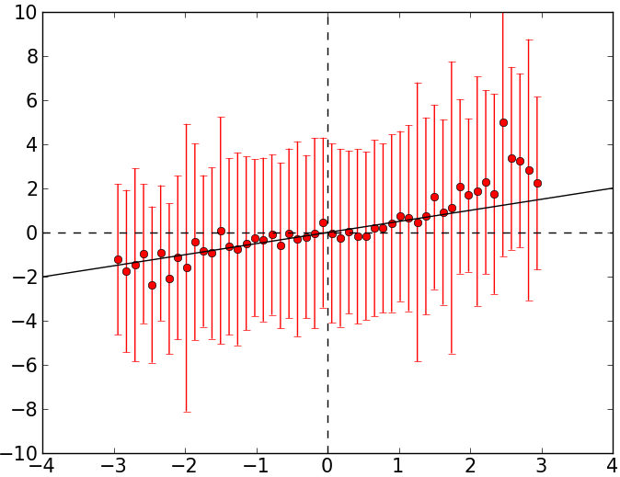
Coupling Coefficient
The coupling coefficient for model data is highly dependent on the stress parameterization.
CUR+WAV
CUR
α=0.89
α=0.76
WAV
CTL
α=0.72
α=0.50

Slide 42
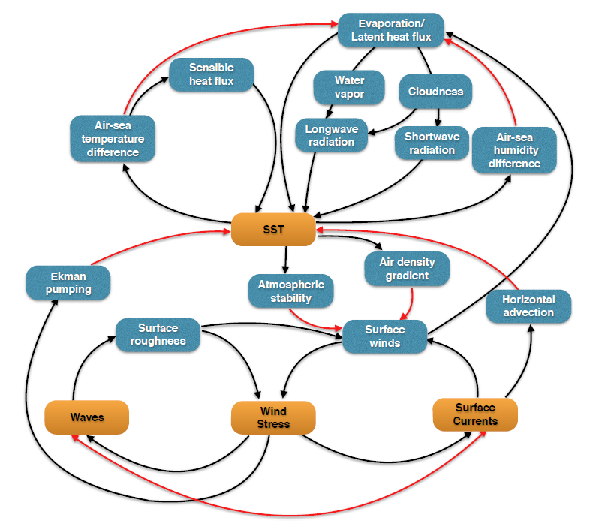
Coupling mechanism
Dominant process
± 20 W/m²
± 5
W/m²
± 3
W/m²
± 9 W/m²
± 588 W/m²
± 387W/m²
?
+12%
±5%
Wave-current interaction
All numbers are median value of 30-day daily differences between CUR+WAV and CTL over the Gulf Stream
Notes:
Differences might be on a shorter time scale – need to check that. Since the result is for the median the answers will still be very similar.
Note that we do not test if changes due stability are more important than changes due to the air temperature gradient. We did verify that both change.

Slide 43
Summary
Mesoscale and submesoscale processes are not sufficiently well understood
  Key areas of interest are
    SST gradients (Allan Clarke also argues salinity gradients)
    Current gradients
    Stress gradients
    Ocean color gradients?
    Fetch changes, and similar terms for river outflow
There appears to be important two-way feed backs between the ocean and the atmosphere – in both directions
  The signature of some of these appears to be on scales that can be resolved by remote sensing, but we have seen that saying responses are qualitatively consistent with conceptual models has led to decades of argument.
    How can we make quantifiable tests?
  These feedbacks appear to be strongest near frontal boundaries and eddy trains
  It is not clear how much the can be observed as an atmospheric plume or subsurface through Argo or other platforms
    How does what happens on the surface link ocean and atmosphere?

Slide 44
Questions?
What are the practical two-way coupling mechanisms to study and to improve understanding (high impact and feasible)?
  open ocean as well as
  coastal where diurnal winds and orography can be important
  Marginal ice zone and other heterogeneities such as river outflow
  Can subsurface or atmospheric constraints be used to improve knowledge of regional surface fluxes?
What are the air-sea fluxes due to submesoscale variability (ocean to atmosphere)? How do these fluxes modify submesoscale structures (atmosphere to ocean)?
  Can the flux-modifying coupled processes be parameterized for coarse resolution models? This is needed for climate models unless models can be run
What can we do to better understand how air-sea fluxes depend on sea state (young or old seas, fetch, and spray) and high winds in general?

